Slide 1


BUILD A DATA STORY
The Movies Dataset
Final Project
Jason Kanhai
Data Analyst for Shell Nanodegree
Sep-29-2021

Slide 2
Executive Summary
The key differentiators of the Top 3 genres of movies based on average popularity from the remaining bottom 17 genres are, in no order of significance:
The budget spent on the movie.
The month movie was released.
The revenue the movie generated.
Our recommendation for any upcoming movies in development that wish to generate revenue would be to:
Create a movie that falls within the top 3 genres (Family, Adventure or Science Fiction)
Ensure sufficient budget is allocated for the movie to ensure success at the box office and generate revenue.
Ensure movies are released within the months of March to June.

Slide 3
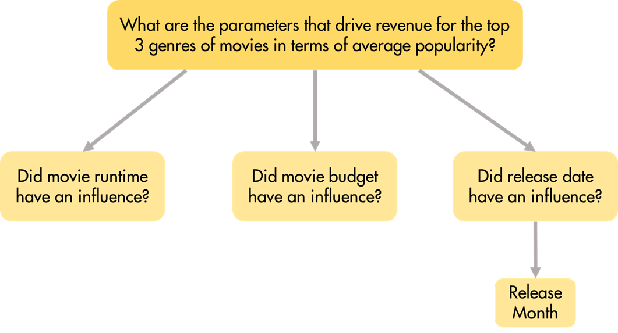
Problem Statement
What are the parameters that drive revenue for the top 3 genres of movies in terms of average popularity?
I focused my analysis on the following workstreams:
Identifying the top 3 genres in terms of average popularity
If runtime affected revenue for movies within these top 3 genres .
If budget affected revenue for these movies.
If the release month in affected revenue for these movies.
Issue Tree
Problem Statement
Hypotheses
Sub-Issue

Slide 4
Top 3 Genres by Average Popularity
Takeaways
The Top 3 Genres of the entire dataset in terms of average popularity are:
Family (19.41)
Science Fiction (13.93)
Adventure (11.76)

Slide 5
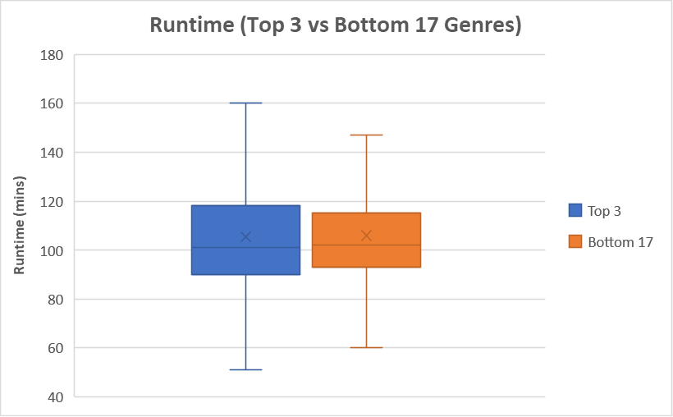
Runtime
Takeaways
The runtime of movies that fall within the top 3 genres in terms of popularity, do not have differing average runtimes (105 minutes) from the bottom 17 genres of movies.

Slide 6
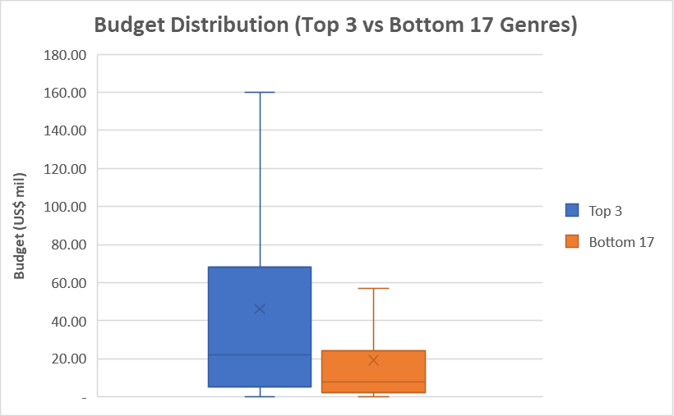
Budget
Takeaways
The mean budget allocated to the top 3 genres of movies (US $46.11 million) is on average greater than the average budget of the bottom 17 genres (US $19.16 million). The top 3 genres also cover a winder range of values for budget.

Slide 7
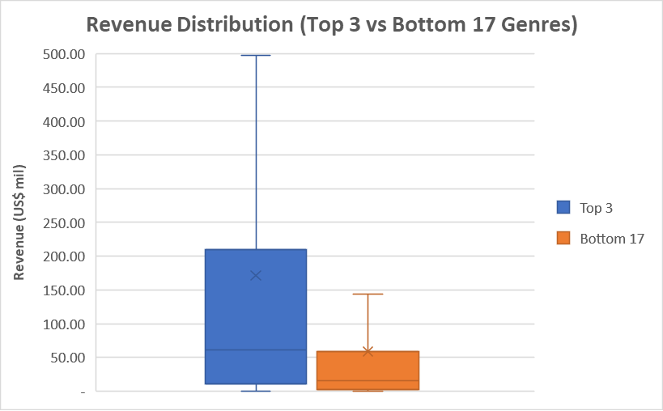
Revenue
Takeaways
For the top 3 genres of movies, the average revenue (US $172.94 million) is greater than that of the bottom 17 genres (US $58.72 million).

Slide 8
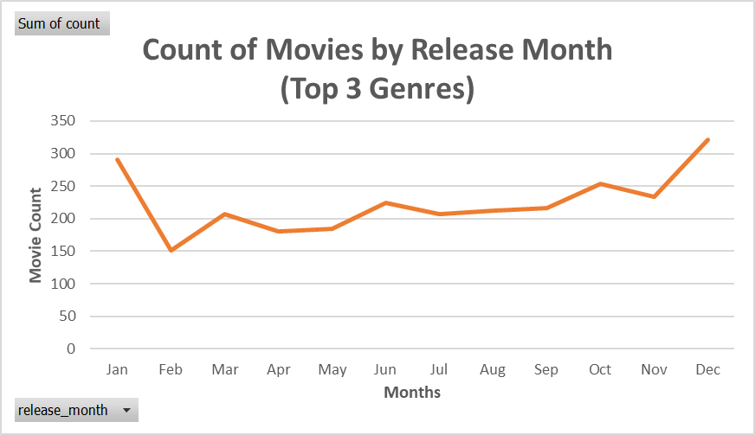
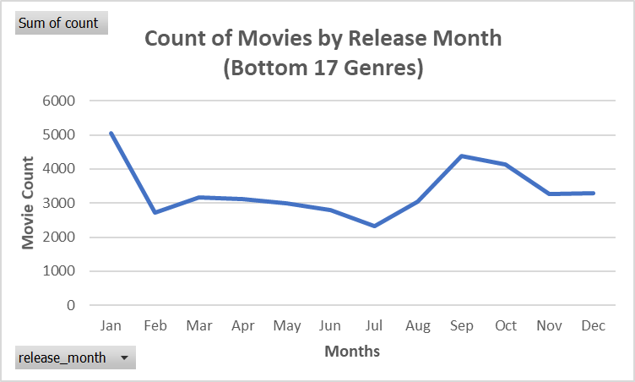
Release Month
Takeaways
Over time, movies that fall within the top 3 genres have a peak release around Christmas time (Dec & January).
Movies that fall within the bottom 17 genres have a peak release in January but also a noticeable peace around September.

Slide 9
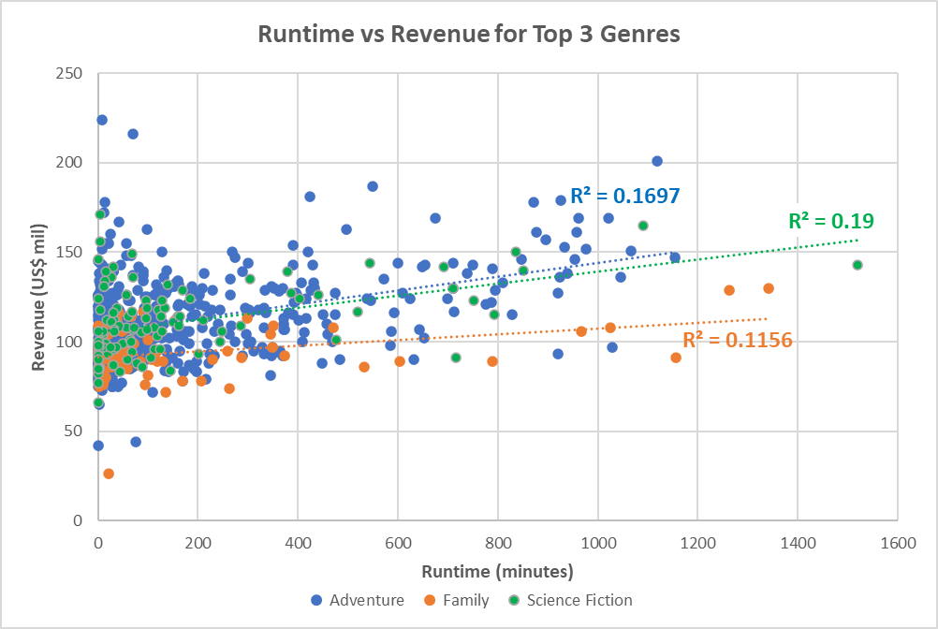
Runtime vs Revenue
Takeaways
A weak although positive relationship exists between movie runtime and the revenue it generates as demonstrated by the R² values (0.11 – 0.19) depending on the genre.
This weak relationship suggest that runtime isn’t the strongest determining factor to a movie’s revenue. Any potential movies in development should not worry about runtime.

Slide 10
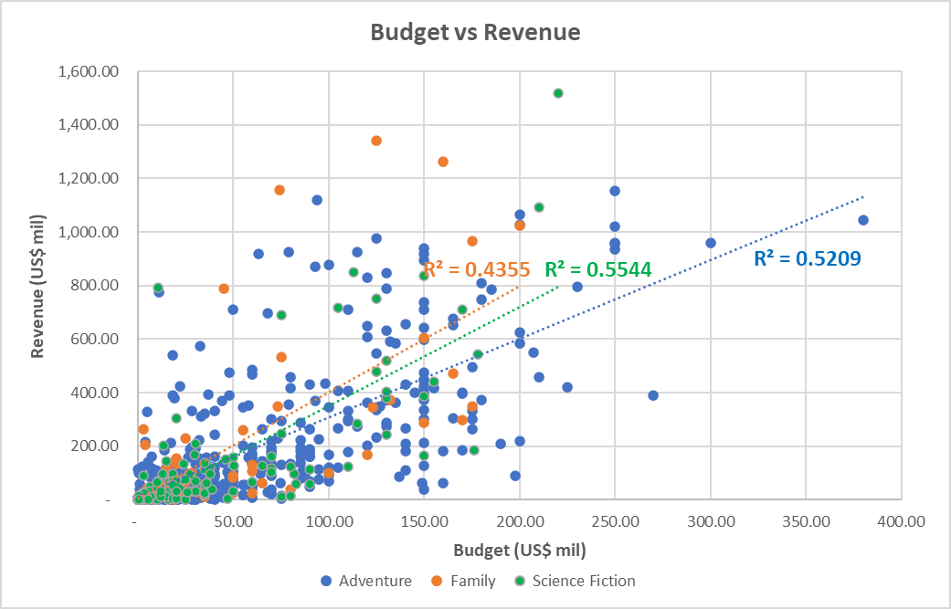
Budget vs Revenue
Takeaways
A significant positive relationship exists between movie budget and the revenue it has generated.
This is demonstrated by the R² values (0.44- 0.55). This suggests that for a movie to make a decent enough revenue, a proportional budget must be allocated.

Slide 11
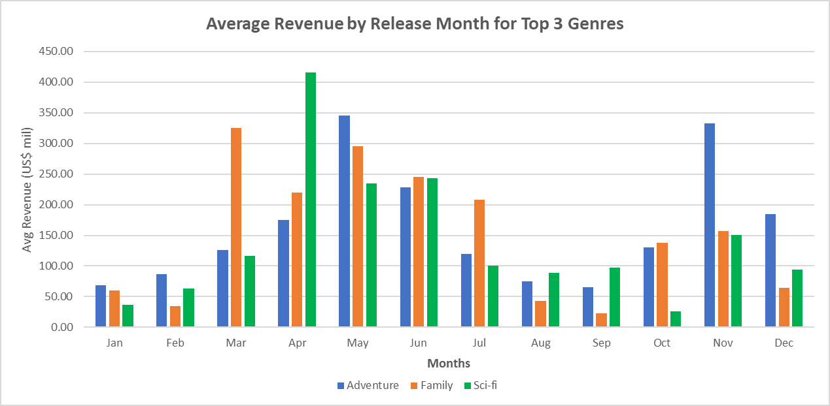
Release Month vs Revenue
Takeaways
For movie that fall within the Top 3 Genres, it appears that average revenue is higher between the months of March to June.
An additional peak appears around November although smaller than the former.
If movies that fall within these genres seek to do well at the box office, they should aim to release within these months.

Slide 12
Release Month vs Revenue
Adventure
Descriptive
Statistics of
Revenue by Release month for Top 3 Genres
Family
Science
Fiction

Slide 13
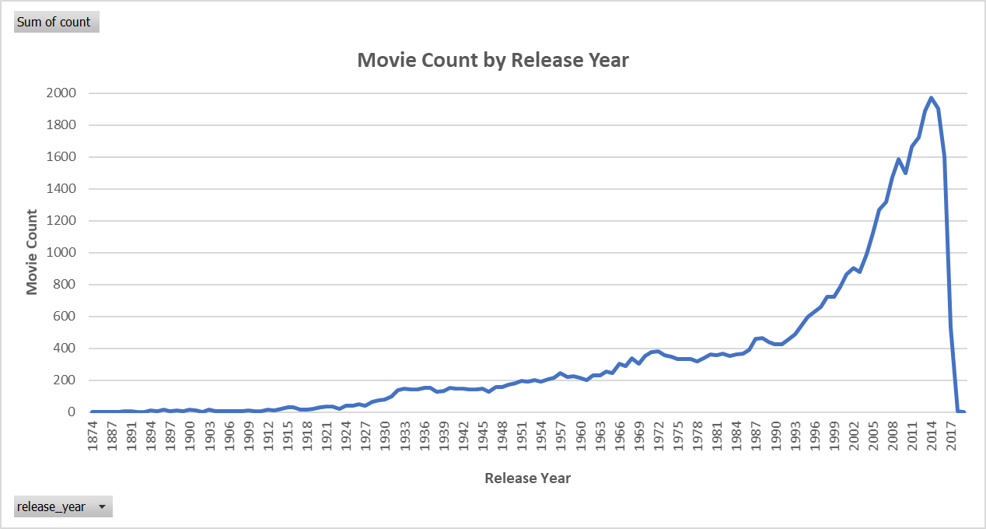
Limitations & Biases (Data Collection)
Biases in Coverage: It should be noted that while this dataset covers movies between 1874 and 2020, as can be seen from the line plot on the right, a significant portion of the data is dominated by recent movies, especially those released after the year 2000.
Given this, all variables with be dominated by data associated with movies that were released by the year 2000 onwards.
Likewise, the budgets and revenues for movies in the past have not been adjusted for inflation and represent their value relative to their release date.

Slide 14
Limitations & Biases (Data Processing & Insight)
Data Processing
It should be noted that 0 and blanks values existed in the following variables used in the analysis:
Budget (MAR) – many values were missing for older movies
Revenue (MAR) – likewise, many values were missing for older movies.
Genre (MCAR)
Release Date (MCAR)
In analyses using these variables, records were removed if there was a zero or blank value, that would have inadvertently skewed the analaysis
Data Insight
While from the provided analyses we can see that revenue has a somewhat strong correlation with budget and release date, it is possible that revenue for the top 3 genres of movies are also controlled by other variables not analysed (eg. Production company, actor) and variables not existing in the provided dataset (marketing, etc).

Slide 15
Next Steps
The proposed next steps for this analysis suggests that:
For movies to succeed in popularity they should fall within the top 3 Genres (Adventure, Family, Science Fiction).
Once within these genres, to generate revenue, a proportional budget should be allocated to the movie
For financial success at the box office, movies within these genres should be released between the months of March to June.
Runtime does not have a significant effect on the revenue a movie within these genres is able to generate.

